Slide 1
What's one skill you possess that you think will contribute significantly to the success of this project team, and how did you develop it?

Slide 2
Lecture 2:
Team development and dynamics

Slide 3
Key topics covered in this lecture

Slide 4
What we will cover in this lecture
Team definitions
Leadership environment
Types of teams
Team formation
High-performance team characteristics
Communication for teams
Meetings types
Critical success factors for teams
Managing teams

Slide 5
Understanding and Managing teams

Slide 6
Introduction
Teams can comprise individual, internal employees and external contractors
Project managers partners with project team in leadership environment as opposed to management environment.
Project managers must be able to effectively develop and lead a project team.
Successful project managers need more than just tools of planning scheduling and controlling.
One of the most important roles of the project manager is to lead the project team.
Notes:
Teams can be virtual, multicultural or distributed and in some cases both.

Slide 7
Team Definitions
A team is “a group of individuals with mutual accountability that work interdependently to solve problems or carry out work” (Kirkman & Mathieu, 2005, 701).
A team is “a group of individuals who work together under a unity of purpose, as a united front.” (Kezsbom (1995, 480)
A team is “a small number of people with complimentary skills who are committed to a common purpose, set of performance goals, and approach for which they hold themselves mutually accountable” (Katzenbach & Smith, 1993, 112)
Notes:
There is a distinction between a team and a group.
Teams are not generally formed voluntarily.
Teams are explicitly designed and developed to meet specific goals.
Groups are usually formed on a long term basis.
Teams are disbanded after achieving a goal.
Team purpose is different from that of an organisation

Slide 8
Leadership vs Management Environment
 | Leadership | Management
Organisational type | Project | Functional
Type of work | Unique work | Similar work
Worker skill level | Highly skilled | Skilled
Authority | Empowers people | Delegates authority
Organisational structure | Team | Hierarchy
Notes:
Management is usually focused on classical functions such as planning, organizing, and controlling.
Leadership, on the other hand, is about motivating and guiding people to realize their potential and achieve tougher and challenging organizational goals.

Slide 9
Types of teams
Functional Teams
Self-directed teams
Cross functional teams
Hybrid teams
Notes:
The functional team structure is probably the one most familiar to the majority of us.
This is the typical hierarchical structure whereby frontline workers report to a first-level supervisor who reports to a manager who reports to a director and so on.
Functional teams are unable to make decisions quickly at low levels of organizations.
Self directed teams allow for free-flowing communication between each team member and between team members and the client community.
Cross functional teams are intimately connected with the clients and with each other to form a cohesive, tight-knit organization.
Cross functional teams allow quick movement and quick change of direction.
Hybrid teams use a mixture of team types depending on the team members and the situation of the particular project.
Hybrid teams are typical in matrix organisation.

Slide 10
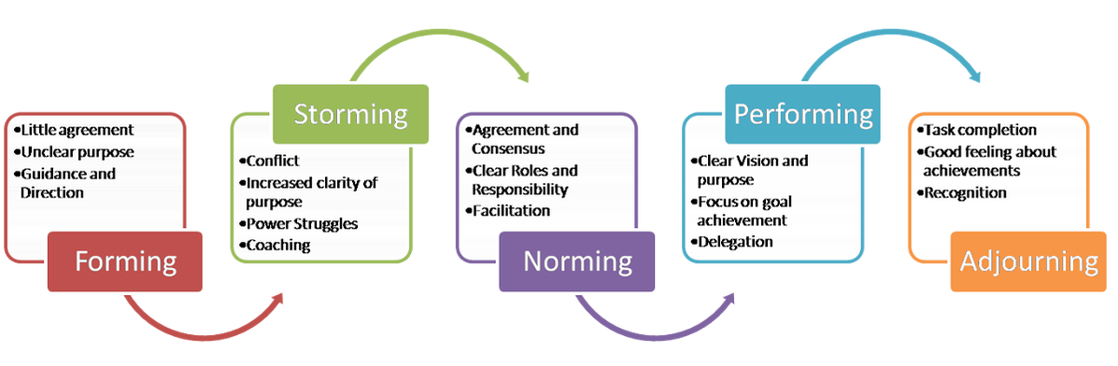
Stages in Team Development
Proposed by Bruce Tuckman in 1965 with four stages and added the fifth in 1970s.
Model explains how the team develops maturity and ability, establishes relationships among the members.
Productivity is very high at forming stage, deeps at storming starts to pick at norming and is at peak at performing stage.
Notes:
Project teams members do not become a team on the day the project start.
They come from different backgrounds.
Though they have a common goal but will have different ways of achieving that goal.
Motivation for a team’s effectiveness and efficiency comes from two distinct and different approaches: task related and people related.

Slide 11
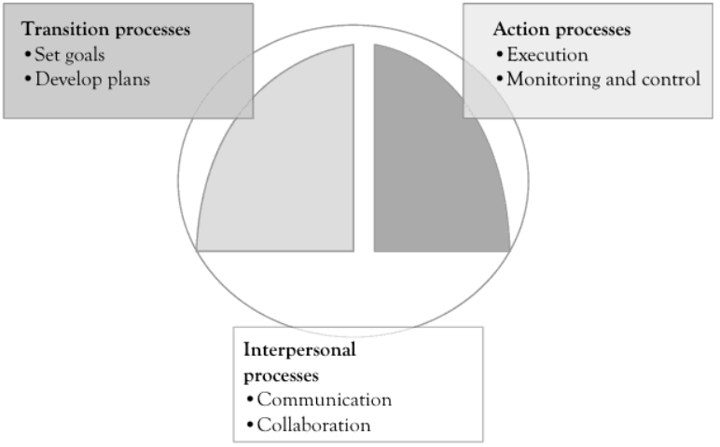
Project Team Processes
Team development can be seen as three action phases.
Team development can be seen as three action phases.
Project Team processes( Anantatmula, 2015)
Notes:
Team development can be seen as three action phases.

Slide 12
High-performance team characteristics
Commitment to a common goal
Clear roles and responsibilities
Informal team atmosphere
Contribution by all members
Civilized disagreement
Consensus decisions
Mutual accountability
Open, frank communication
Active listening

Slide 13
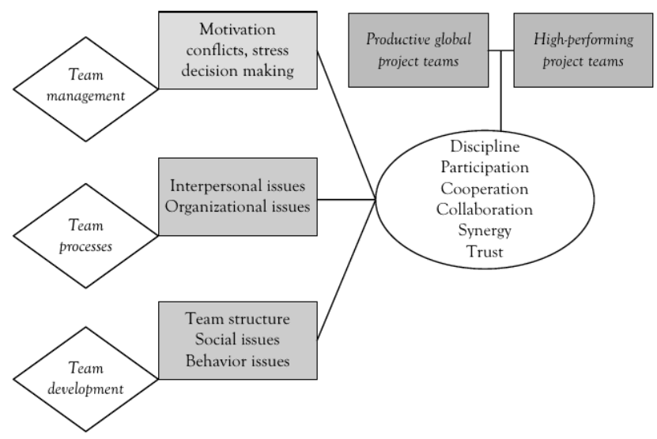
Project team Efficacy Model
Project Efficacy Model (Anantatmula, 2015:16)
Notes:
Understanding social and behavioural issues and developing team processes to address such issues, and team management matters in regard to conflict resolution and stress management.
All of these items are of importance in the development of high-performing project teams

Slide 14
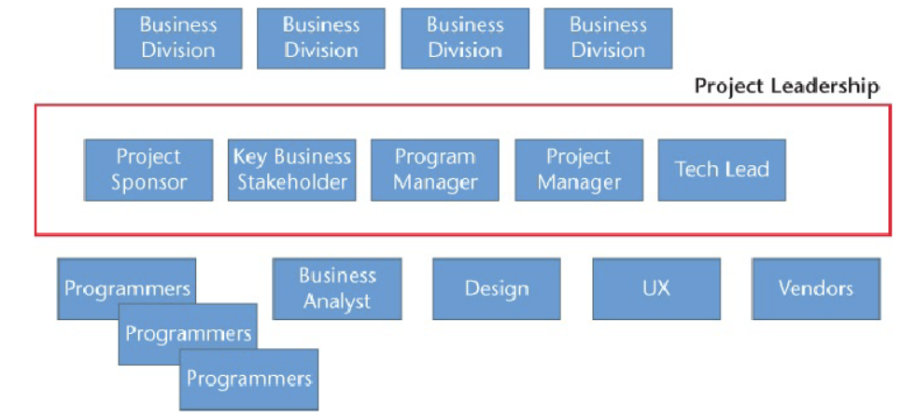
Project leadership
Project Leadership Murray, A. P. (2016)
Notes:
The project leadership can be understood as a bridge between the “techies” and the business.
Project sponsor-tasked with overseeing the software development project and with the accountability for its success or failure.
Program Manager-calls the meetings, gives directions, identifies needs, and leads all the other team members through the processes (we will discuss) of deciding on technology, picking team members and vendors, gathering business requirements, breaking down the project into tracks.
Project Manager- is in charge of interacting daily with the technical team, making and tracking the detailed plans, and using project management tools to report on progress.

Slide 15
Communication for teams
Communication is an essential element of success in the fast-paced environment in which technical project teams operate these days.
Formal Systems
Informal Systems-
Notes:
Effective communications boils down to saying (or relaying) the right information
Communication is done with senior executives, project team and with external stakeholders

Slide 16
Formal Systems
Face-to-Face meetings- must have purpose, agenda, limits, facilitator, recorder, adequate facilities.
Video conferencing
Teleconferencing
On-line chat systems
Reports charts and graphs

Slide 17
Informal Systems
Spontaneous conversation
Ad hoc telephone calls
E-mail
Notes:
Often not taken seriously but strong bonds are made here.
Internal communication must be monitored and feedback loops exist
Intellectual barriers, psychological barriers, political barriers.
Communication with outside world-The project team must be clear on what information stakeholders, sponsors, and supporters need and require.

Slide 18
Team communication
Communication with senior managers | Communication with project team | Communication with stakeholders
Use exception reports periodic reports project charters E-mails) Reviews (in person and through reports) | Status reports Meetings E-mails Reviews (in person or through reports Kanban boards | Communication plan Contracts Statement of work Purchase orders Deliverable prototypes Compliance reports
Notes:
There are a lot of uncertainties and unknowns and these can lead to decreased motivation and participation
Best way to manage these is through communication

Slide 19
STATUS REPORTING
Teams have to report to the project manager about progress
Ways of reporting on progress:
Progress review meetings – progress of the project is reviewed against the project plan.
Project progress reports – written reports about the progress of the project are prepared. Reports include information on actual & intended achievements.

Slide 20
Meeting types
Four types of meetings usually take place in a project:
Progress meetings: - takes place regularly, usually weekly. Focus: the actual progress made by the project teams against a planned progress.
Vendor (supplier) meetings:- takes place regularly, once a month. Deliveries that have already been made will be discussed as well as progress on deliveries that still have to be made.
Project board/project steering committee meetings: - takes monthly or every two months. Keeps project board / steering committee up-to-date with the project progress. Any deviations, changes or problems will be discussed or resolved.
AD hoc meetings: - meetings are scheduled as needed when a specific topic need to be discussed & a decision need to be made immediately.

Slide 21
Project progress reports
Weekly team meetings will focus only on exceptions/problems:
Project progress report would typically include:
Actual versus planned progress
Gantt chart
Reasons for deviations
Milestones & deliverables completed
Areas of concern
Focus for the next week
General comments

Slide 22
Critical success factors for teams
Build a strong business case.
Gain organisational commitment to the team.
Give the team the confidence that it can succeed
Partner with the project customer
Partner with external vendors
Enable team members to succeed
Encourage personal growth
Notes:
Teams are more confident if they are empowered to create project mission, CSF, project scope.
Project team must develop a “we mentality” with the customer
Motivate team members to develop a personal vision

Slide 23
Managing Teams
Organizational culture plays key role in shaping : employee behaviour, leadership style, decision making processes and employee satisfaction and engagement
Mainly consists of shared values, beliefs, customs, attitudes, and norms.
Organisational culture can fall between egalitarian and hierarchy.
Delegation of authority, responsibility, and accountability are indicators of the power distance culture in an organization.
Team roles: Task roles, socioemotional roles and destructive roles
Project managers must define unique roles to reduce social loafing.
As part of managing teams, project managers will encounter conflicts.
Notes:
Power distance" is a concept that refers to the extent to which individuals in a society or an organization accept and expect unequal distribution of power.

Slide 24

Discussion
Discuss factors that increase/reduce social loafing.
ⓘ Start presenting to display the poll results on this slide.

Slide 25
Decision making in teams
Using logic to make decisions is based on either deductive (principles-first) or inductive (applications-first).
Leaders are often made or broken by their decisions.

Slide 26
Conflict in Teams
Conflict refers to a situation where there is a disagreement, discord, or opposition among individuals or groups involved in a project.
Conflict may arise from differences i in perception, beliefs, incompatible goals or opinion among team members.
Conflict is natural part of team environment.
Conflicts are categorised into two groups: cognitive conflict and affective conflict.

Slide 27
Cognitive vs Affective conflicts
“Cognitive conflict refers to disagreements and different ideas that are associated with the work”. (Anantatmula, 2015:84)
Cognitive conflict is task related.
Affective conflict arises out of personal differences and personality clashes.
Affective conflicts are interpersonal and usually occur at individual level.

Slide 28
Sources of conflict
People | Project Facets
Personality Attributes Ethical differences Trust Commitment Communication Attitude Integrity Power dynamics | Project Resources Cost Duration Schedule Risk Scope Quality
Culture Individual Society Organisation Nation | Project Management Processes/procedures Practices Standards Policies

Slide 29
Conflict Management strategies
Forcing Approach
Accommodating
Avoiding
Compromising
Collaborating

Slide 30

Strategy choice of managing conflict
Which of the discussed strategies do you consider to be the best way of managing conflict?
ⓘ Start presenting to display the poll results on this slide.

Slide 31
Impact of conflicts
Project delays
Team morale
Quality compromises
Client relationships

Slide 32
The Dos and Don’ts of Managing Conflict
Don’t rely on consensus or voting
Don’t turn a blind eye to simmering issues
Don’t take it out on other teams.
Don’t be afraid.
Do set up clear processes to depersonalize decisions.
Do address issues without courting drama.
Do remember to be kind. It’s natural and perfectly human to want to be liked by other people.
Do get curious.
Notes:
Conflict-avoidant managers often seek conflict when it comes to other teams.

Slide 33
Summary

Slide 34
Key takeaway points
Five stages in team development stages
Defining Team
Leadership vs Management environment
Types of teams
High-performance team characteristics
Significance of communication for teams
Identifying and managing conflicts

Slide 35


How do you rate today's engagement?
ⓘ Start presenting to display the poll results on this slide.

Slide 36
References
Seymour, T. and Hussein, S., 2014. The history of project management. International Journal of Management & Information Systems (IJMIS), 18(4), pp.233-240.
Richman, L. (2002). Project Management Step-by-Step, AMACOM, 2002.
Williams, J. (2002). Team Development for High Tech Project Managers, Artech House.
Murray, A. P. (2016). The Complete Software Project Manager : Mastering Technology from Planning to Launch and Beyond, John Wiley & Sons, Incorporated.
Anantatmula, V. S. (2015). Project Teams : A Structured Development Approach, Business Expert Press.

